Slide 1


Python – List & Tuples
M M Mahbubul syeed, phd. Associate professor

Slide 2
Highlight
List – what is it!!??
Why we use list?!.
Construction (memory and index) of a list.
List operations (basic).
List operations (built in functions).
List operations (list functions).

Slide 3
List
list1 = [1, 2, 3, 4, 5 ]
list1
1 | 2 | 3 | 4 | 5

Slide 4
List – What is it?!
A list is a data structure in Python that is a mutable, or changeable, ordered sequence of elements.
Each element or value that is inside of a list is called an item.
Memory
Example:
list1 = [1, 2, 3, 4, 5 ]
list2 = ["a", "b", "c", "d"]
List3 = [] //Creating an empty list
list1
1 | 2 | 3 | 4 | 5
list2
a | b | c | d

Slide 5
List – Why?
To store ordered list of items, e.g., list of students, list of products, list of prices, list of marks.
To carry out different useful operations on the list, e.g., sorting the marks, find min/max marks or price
Manipulating list items / data (add, remove, modify), e.g., adding new students in the list, changing price of a product.
Combining two or more lists together, e.g., combining list of CSE students and list of EEE students to get a full list of students in the University.
To create graphical representation of data, e.g., show list of items in the user interface!

Slide 6
List – What is it?!
List can be written as a comma-separated values (items) between square brackets.
Important thing about a list is that the items in a list need not be of the same type.
Index of a List starts with 0 (from left to right).
Index of a List starts with -1 (from right to left).
index or indices
Memory
Memory Location
Left to right
Example:
list1 = [1, 2, 3, 4, 5 ]
0 | 1 | 2 | 3 | 4
list1
1 | 2 | 3 | 4 | 5
-5 | -4 | -3 | -2 | -1
Memory Location
Right to left

Slide 7
List – accessing list items
List items can be accessed with slicing operator ([]).
Index of a List starts with 0 (from left to right).
Index of a List starts with -1 (from right to left).
list1 = [1, 2, 3, 4, 5 ]
print(list1)
print(list1[1])
print(list1[1:3])
print(list1[2:])
print(list1[-2])
print(list1[-3:])
print(list1[-4:-1])
print(list1[-4:])

Slide 8
List – accessing list items
List items can be accessed with slicing operator ([]).
list1 = [1, 2, 3, 4, 5 ]
print(list1)
print(list1[1])
print(list1[1:3])
print(list1[2:])
print(list1[-2])
print(list1[-3:])
print(list1[-4:-1])
print(list1[-4:])
print(list1[:])
Output
[1, 2, 3, 4, 5]
2
[2, 3]
[3, 4, 5]
4
[3, 4, 5]
[2, 3, 4]
[2, 3, 4, 5]
[1, 2, 3, 4, 5]
Memory
Memory Location
Left to right
0 | 1 | 2 | 3 | 4
list1
1 | 2 | 3 | 4 | 5
-5 | -4 | -3 | -2 | -1
Memory Location
Right to left

Slide 9
List – items can be of different types!!
Important thing about a list is that the items in a list need not be of the same type.
Output???
list1 = ['physics', 'chemistry', 1997, 2000]
list2 = [1, 2, 'a', 4, 'It is raining today', 6, -7 ]
print ("list1[0]: ", list1[0])
print(list2)
print ("list2[4:]: ", list2[4:])
print('list2[2]: ', list2[2])
print('list2[-5]: ', list2[-5])

Slide 10
List – items are mutable
List items are mutable, or changeable.
Update or change a single or multiple elements of lists by giving the slice on the left-hand side of the assignment operator.
Output???
list1 = [1, 2, 'a', 4, 'It is raining today', 6, -7 ]
print ("list1[2]: ", list1[2])
list1[2] = 'apple'
print ("After change list1[2]: ", list1[2])
list1[3:5] = ['This is me!!', 984401]
print ("list1: ", list1)

Slide 11
List – items can be deleted
Use the del statement if you know exactly which element(s) you are deleting.
list = ['physics', 'chemistry', 1997, 2000, 'Raining!', 1976]
print (list)
del list[2]
print ("After deleting value at index 2 : ", list)
del list[-2:]
print ("After deleting values: ", list)
Output???
['physics', 'chemistry', 1997, 2000, 'Raining!', 1976]
After deleting a value: ['physics', 'chemistry', 2000, 'Raining!', 1976]
After deleting values: ['physics', 'chemistry', 2000]

Slide 12
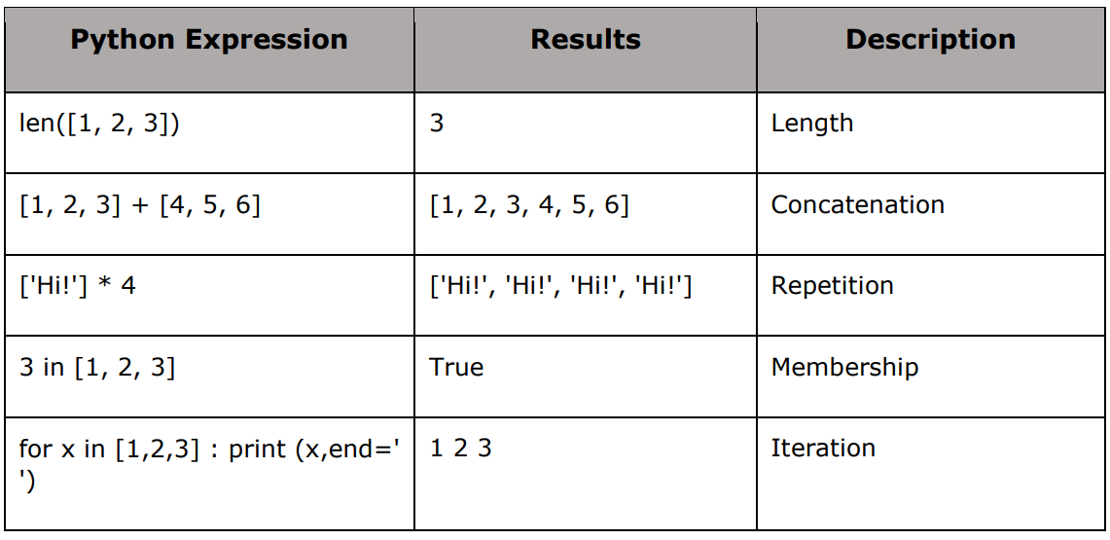
List – Basic Operations

Slide 13
List – Basic Operations
list = ['physics', 'chemistry', 1997, 2000, 'Raining!', 1976]
print ('Total items in list: ', len(list))
inList = 'chemistry' in list
print('is chemistry in the list: ', inList)
for item in list:
print(item, end =' ')
print('\n list id: ', id(list))
list2 = [1,2]
list = list + list2
print(list)
print('list id: ', id(list))
print('list2 id: ', id(list2))
list2 = list2*3
print(list2)
print('list2 id: ', id(list2))
Output???
Total items in list: 6
is chemistry in the list: True
physics chemistry 1997 2000 Raining! 1976
list id: 3100435584768
['physics', 'chemistry', 1997, 2000, 'Raining!', 1976, 1, 2]
list id: 3100436074752
list2 id: 3100435755648
[1, 2, 1, 2, 1, 2]
list2 id: 3100435756608

Slide 14
Built in Functions

Slide 15
List – Built in function
 | List of built in functions
1 | len(list) Gives the total length of the list.
2 | max(list) Returns item from the list with max value.
3 | min(list) Returns item from the list with min value.
4 | list(seq) Converts a tuple into list.

Slide 16
List – Built in function
list1, list2 = ['C++','Java', 'Python'], [456, 700, 200]
print ('Total items in list: ', len(list1))
print ("Max value element : ", max(list1))
print ("Max value element : ", max(list2))
print ("Min value element : ", min(list1))
print ("Min value element : ", min(list2))
aTuple = (123, 'C++', 'Java', 'Python')
print(aTuple)
list1 = list(aTuple)
print ("List elements : ", list1)
str="Hello World"
print(str)
list2=list(str)
print ("List elements : ", list2)
Output???
Total items in list: 3
Max value element : Python
Max value element : 700
Min value element : C++
Min value element : 200
(123, 'C++', 'Java', 'Python')
List elements : [123, 'C++', 'Java', 'Python']
Hello World
List elements : ['H', 'e', 'l', 'l', 'o', ' ', 'W', 'o', 'r', 'l', 'd']

Slide 17
List Functions

Slide 18
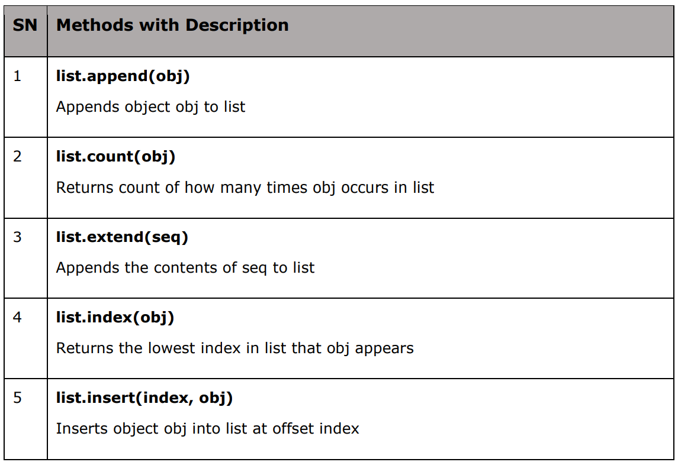
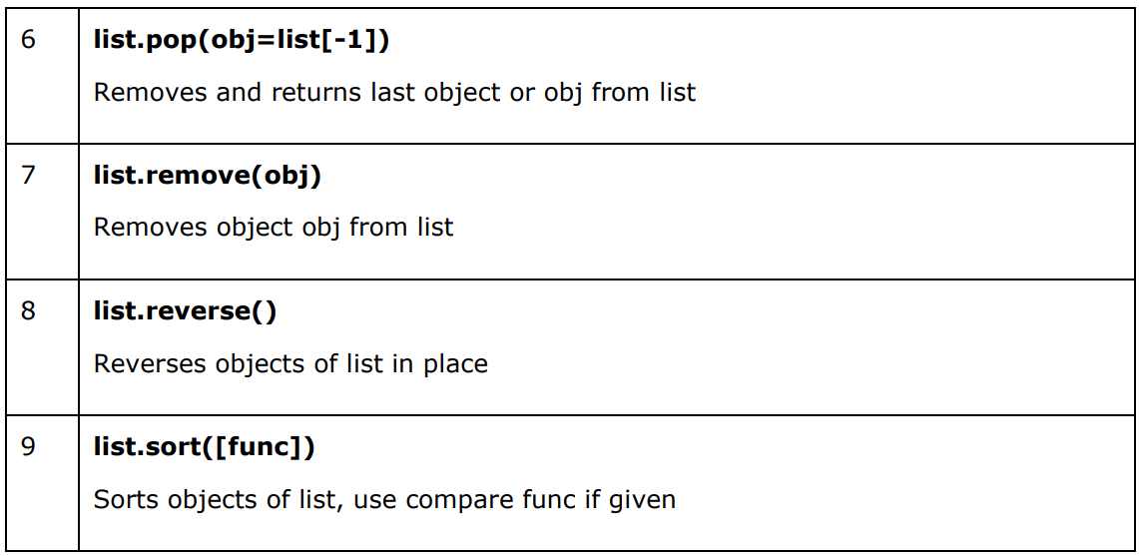
List – functions
list.pop(index=-1)
Removes and returns the last object or object at index from the list

Slide 19
List – function
list1 = ['C++', 'Java', 'Python’]
list1.append('C#')
print ("updated list : ", list1)
aList = [123, 'xyz', 'zara', 'abc', 123];
print ("Count for 123 : ", aList.count(123))
print ("Count for zara : ", aList.count('zara'))
list2 = ['JS', 'DJango']
list1.extend(list2)
print (list1)
ind = list1.index('JS')
print('index of JS is: ', ind)
list1.insert(2, 'Python-3')
print(list1)
Output???
updated list : ['C++', 'Java', 'Python', 'C#']
Count for 123 : 2
Count for zara : 1
['C++', 'Java', 'Python', 'C#', 'JS', 'DJango']
index of JS is: 4
['C++', 'Java', 'Python-3', 'Python', 'C#', 'JS', 'DJango']

Slide 20
List – function
list1.pop(2)
list1 = ['C++', 'Java', 'Python', 'C#', 'JS']
print(list1)
poppeditem = list1.pop()
print('item popped: ', poppeditem)
print(list1)
list1.remove('Java')
print(list1)
list1.reverse()
print(list1)
list1.sort()
print(list1)
list = ['Python', 3, 'C#']
list.sort()
print(list)
Output???
['C++', 'Java', 'Python', 'C#', 'JS’]
item popped: JS
['C++', 'Java', 'Python', 'C#']
['C++', 'Python', 'C#']
['C#', 'Python', 'C++']
['C#', 'C++', 'Python']
Traceback (most recent call last):
File "c:\Users\M SYEED\OneDrive - American International University-Bangladesh\Desktop\Lab19\list.py", line 18, in <module>
list.sort()
TypeError: '<' not supported between instances of 'int' and 'str'

Slide 21
List
Exercise

Slide 22
List – Exercise
Create a list of N numbers. N must be taken as an input from the user. After inserting all the
User input numbers in the list, do the followings:
Print the full list of numbers
Sort the list and print the sorted list.
Print how many numbers are there in the list.
Find the max number in the list
Find the min number in the list
Find the summation of all the numbers in the list and print the
summation value.
How many numbers: 4
number: 36
number: 25
number: 30
number: 25
List of numbers are: ['36', '25', '30', '25']
After Sorting: ['25', '25', '30', '36']
Total numbers are: 4
Max number: 36
Min number: 25
summation of all vaules is: 116

Slide 23
List – Exercise Solution
numberList = list()
i = 0
n = int(input('How many numbers: '))
while i < n:
numberList.append(input('number: '))
i+=1
print('List of numbers are: ', numberList)
numberList.sort()
print('After Sorting: ', numberList)
print('Total numbers are: ', len(numberList))
print('Max number: ', max(numberList))
print('Min number: ', min(numberList))
i = 0
sum = 0
while i < len(numberList):
sum += int(numberList[i])
i += 1
print('summation of all vaules is: ', sum)
Output???

Slide 24
2D List

Slide 25
Consider the example of recording temperatures 4 times a day, every day.
Day 1 - 11 12 5 2
Day 2 - 15 6 10
Day 3 - 10 8 12 5
Day 4 - 12 15 8 6
The above data can be represented as a two-dimensional list as below.
T = [ [11, 12, 5, 2], [15, 6,10], [10, 8, 12, 5], [12,15,8,6] ]

Slide 26
To print out the entire two-dimensional list we can use python for loop
T = [[11, 12, 5, 2], [15, 6,10], [10, 8, 12, 5], [12,15,8,6]]
for r in T:
for c in r:
print( c, end = " ")
print()
11 12 5 2
15 6 10
10 8 12 5
12 15 8 6

Slide 27
Inserting Values in 2D list
T = [[11, 12, 5, 2], [15, 6,10], [10, 8, 12, 5], [12,15,8,6]]
T.insert(2, [0,5,11,13,6])
for r in T:
for c in r:
print(c,end = " ")
print()
11 12 5 2
15 6 10
0 5 11 13 6
10 8 12 5 1
2 15 8 6

Slide 28
Updating Values in 2D list
T = [[11, 12, 5, 2], [15, 6,10], [10, 8, 12, 5], [12,15,8,6]]
T[2] = [11,9]
T[0][3] = 7
for r in T:
for c in r:
print(c, end = " ")
print()
11 12 5 7
15 6 10
11 9
12 15 8 6

Slide 29
Deleting Values in 2D list
T = [[11, 12, 5, 2], [15, 6,10], [10, 8, 12, 5], [12,15,8,6]]
del T[3]
del T[0][2]
for r in T:
for c in r:
print(c,end = " ")
print()
11 12 5 2
15 6 10
10 8 12 5
11 12 2
15 6 10
10 8 12 5

